Slide 1
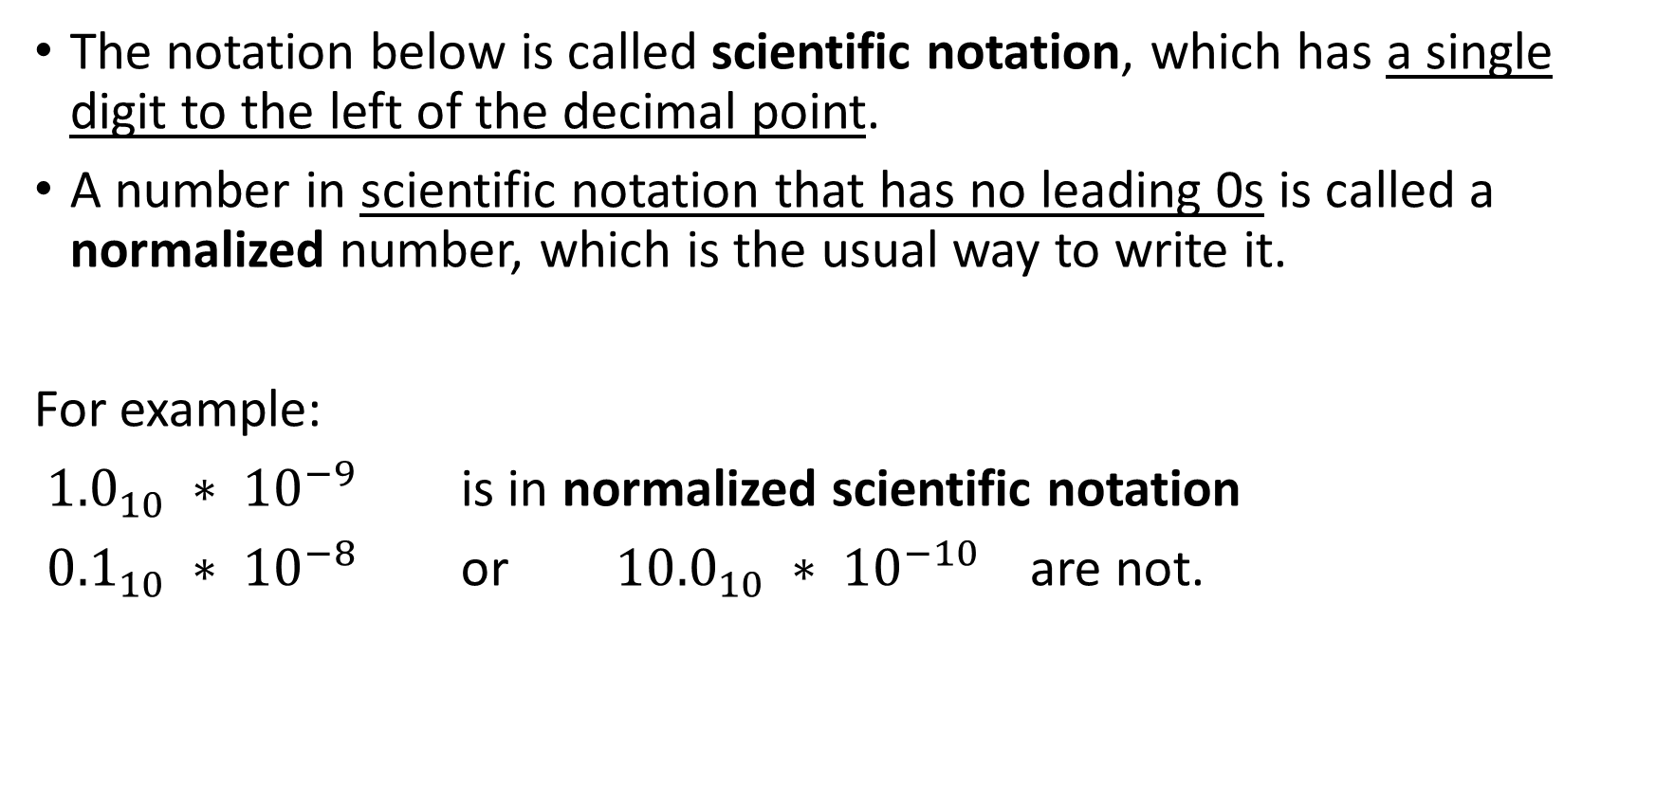
Floating Point
The notation below is called scientific notation, which has a single digit to the left of the decimal point.
A number in scientific notation that has no leading 0s is called a normalized number, which is the usual way to write it.
For example:
${1.0}_{10} ∗ {10}^{−9}$ is in normalized scientific notation
${0.1}_{10} ∗ {10}^{−8}$ or ${10.0}_{10} ∗ {10}^{−10}$ are not.

Slide 2
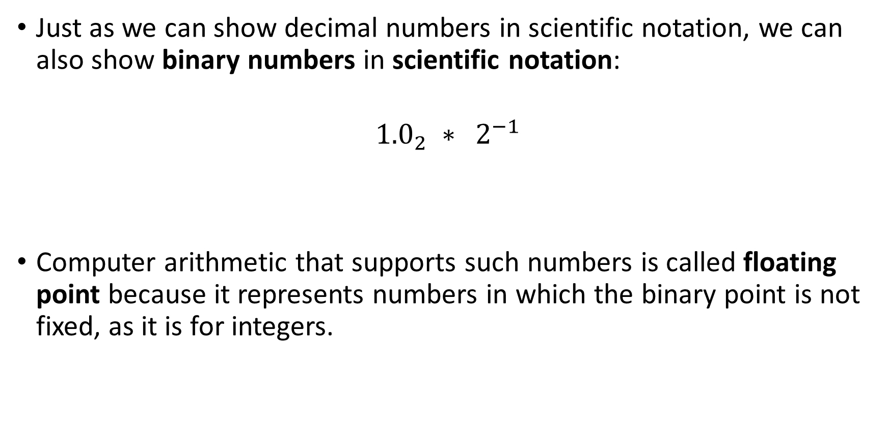
Floating Point
Just as we can show decimal numbers in scientific notation, we can also show binary numbers in scientific notation:
$${1.0}_{2} ∗ 2^{−1}$$
Computer arithmetic that supports such numbers is called floating point because it represents numbers in which the binary point is not fixed, as it is for integers.

Slide 3
Floating Point – Why normalized is better?
Standard scientific notation for reals in normalized form offers three advantages.
It simplifies exchange of data that includes floating-point numbers
It simplifies the floating-point arithmetic algorithms to know that numbers will always be in this form
It increases the accuracy of the numbers that can be stored in a word, since the unnecessary leading 0s are replaced by real digits to the right of the binary point

Slide 4
Floating Point Representation
A designer of a floating-point representation must find a compromise between the size of the fraction and the size of the exponent
Because a fixed word size means you must take a bit from one to add a bit to the other.
This tradeoff is between precision and range:
Larger fraction size -> more precision of the fraction
Larger exponent size -> bigger range of numbers that can be represented

Slide 5

Floating Point Representation
The representation of a MIPS floating-point number is shown below, where:
s is the sign of the floating-point number (1 meaning negative)
exponent is the value of the 8-bit exponent field (including the sign of the exponent)
fraction is the 23-bit number
$${\left(−1\right)}^{s} ∗ F ∗ 2^{E}$$
Notes:
Floating-point numbers are usually a multiple of the size of a word.

Slide 6
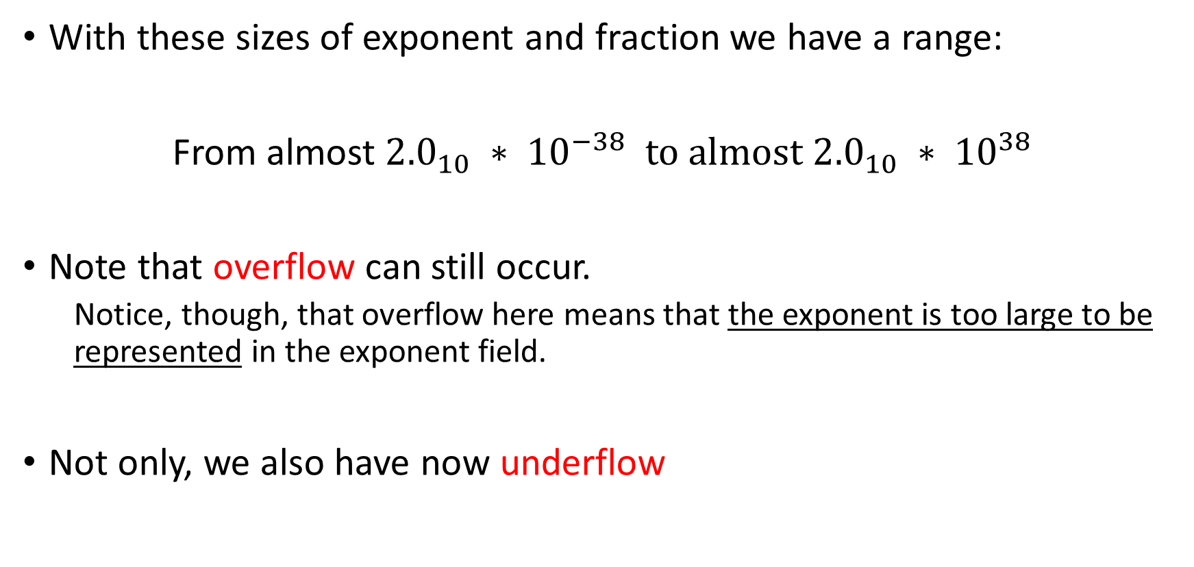
Floating Point Representation
With these sizes of exponent and fraction we have a range:
From almost ${2.0}_{10} ∗ {10}^{−38}$ to almost ${2.0}_{10} ∗ {10}^{38}$
Note that overflow can still occur.
Notice, though, that overflow here means that the exponent is too large to be represented in the exponent field.
Not only, we also have now underflow

Slide 7
Floating Point Representation
Underflow: Programmers want to know if the non-zero fraction they are calculating has become so small that it cannot be represented
To distinguish it from overflow, we call this event underflow
This situation occurs when the negative exponent is too large to fit in the exponent field

Slide 8
Floating Point Representation
One way to reduce chances of underflow or overflow is to offer another format that has a larger exponent
In C this number is called double, double precision floating-point
single precision floating point is the name of the earlier format

Slide 9
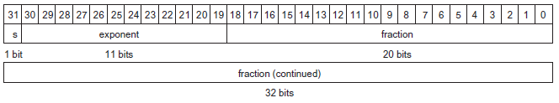
Floating Point Representation
The representation of a double precision floating-point number takes two MIPS words, where:
s is still the sign of the number
exponent is the value of the 11-bit exponent field
fraction is the 52-bit number in the fraction field

Slide 10
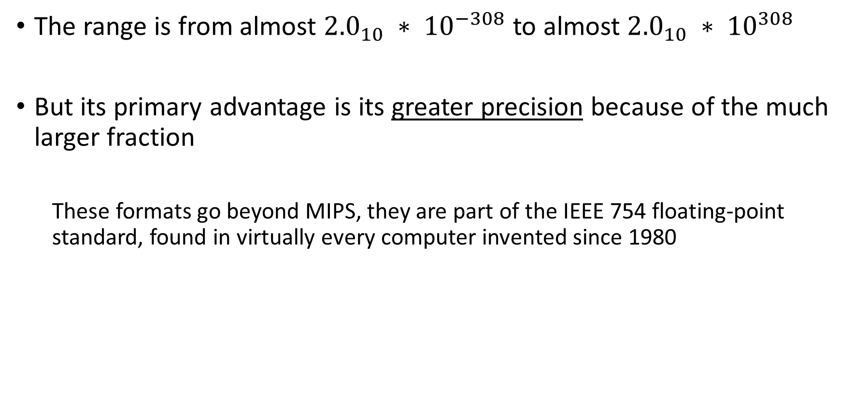
Floating Point Representation
The range is from almost ${2.0}_{10} ∗ {10}^{−308}$to almost ${2.0}_{10} ∗ {10}^{308}$
But its primary advantage is its greater precision because of the much larger fraction
These formats go beyond MIPS, they are part of the IEEE 754 floating-point standard, found in virtually every computer invented since 1980

Slide 11
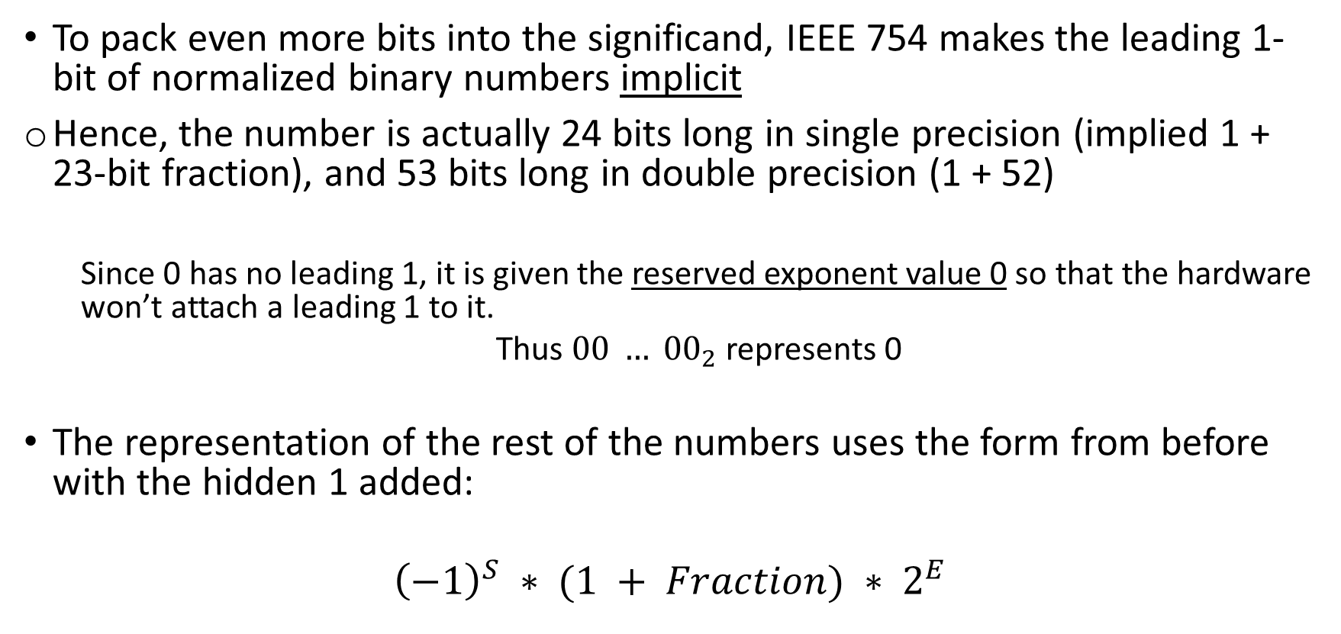
Floating Point Representation
To pack even more bits into the significand, IEEE 754 makes the leading 1-bit of normalized binary numbers implicit
Hence, the number is actually 24 bits long in single precision (implied 1 + 23-bit fraction), and 53 bits long in double precision (1 + 52)
Since 0 has no leading 1, it is given the reserved exponent value 0 so that the hardware won’t attach a leading 1 to it.
Thus $00 … {00}_{2}$represents 0
The representation of the rest of the numbers uses the form from before with the hidden 1 added:
$${\left(−1\right)}^{S} ∗ (1 + Fraction) ∗ 2^{E}$$

Slide 12
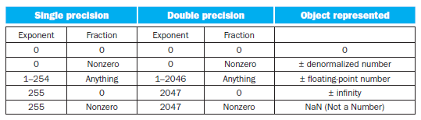
IEEE 754 even has a symbol for the result of invalid operations, such as 0/0 or subtracting infinity from infinity.
The symbol is NaN, for Not a Number.

Slide 13
Floating Point Representation
Why the first bit is the sign?
This allows for a quick test of less than, greater than, or equal to 0
Why the exponent is before the significand?
It simplifies the sorting of floating-point numbers using integer comparison instructions
Notes:
Since numbers with bigger exponents look larger than numbers with smaller exponents, as long as both exponents have the same sign.

Slide 14
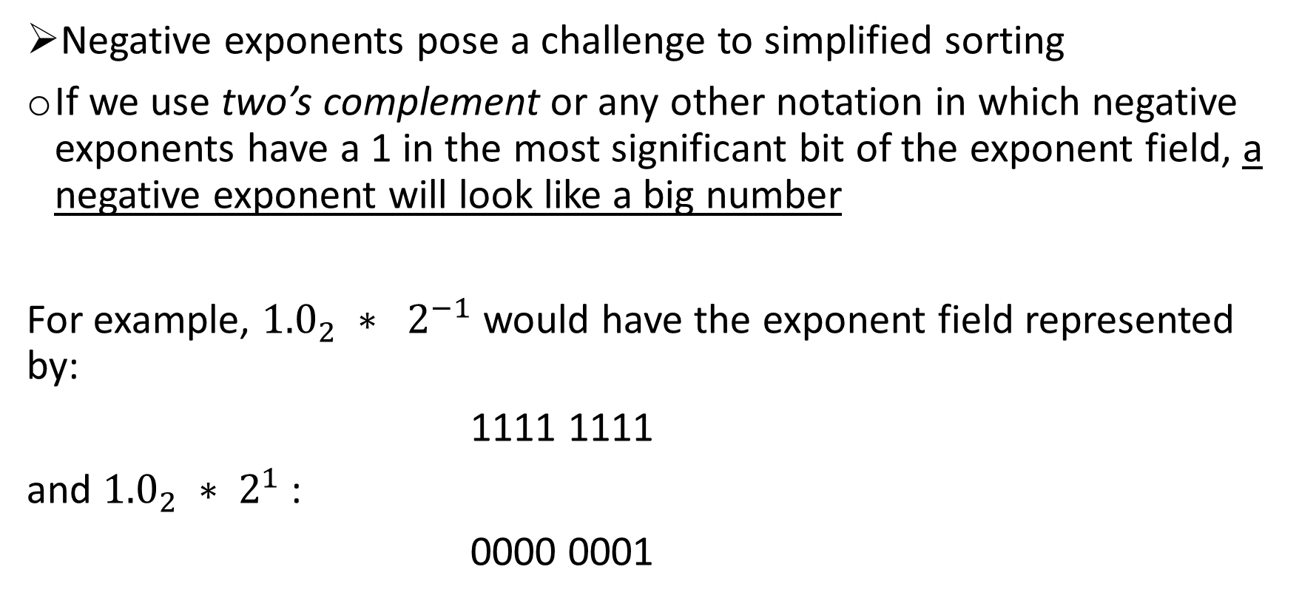
Floating Point Representation
Negative exponents pose a challenge to simplified sorting
If we use two’s complement or any other notation in which negative exponents have a 1 in the most significant bit of the exponent field, a negative exponent will look like a big number
For example, ${1.0}_{2} ∗ 2^{−1}$would have the exponent field represented by:
1111 1111
and ${1.0}_{2} ∗ 2^{1}$:
0000 0001

Slide 15
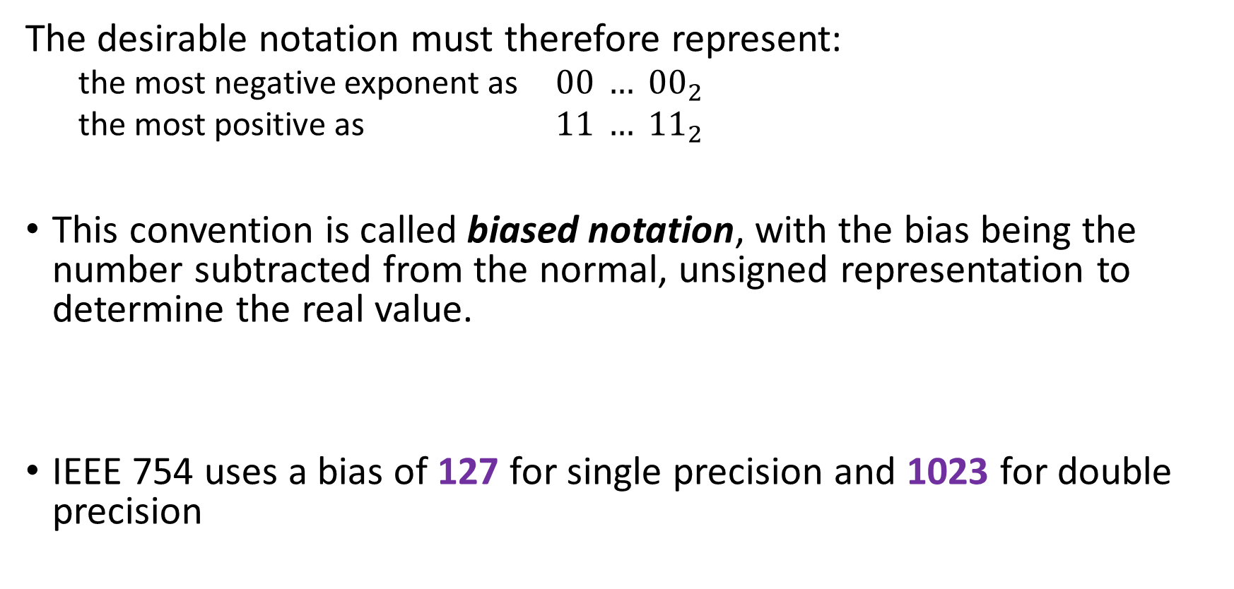
Floating Point Representation
The desirable notation must therefore represent:
the most negative exponent as $00 … {00}_{2}$
the most positive as $11 … {11}_{2}$
This convention is called biased notation, with the bias being the number subtracted from the normal, unsigned representation to determine the real value.
IEEE 754 uses a bias of 127 for single precision and 1023 for double precision

Slide 16
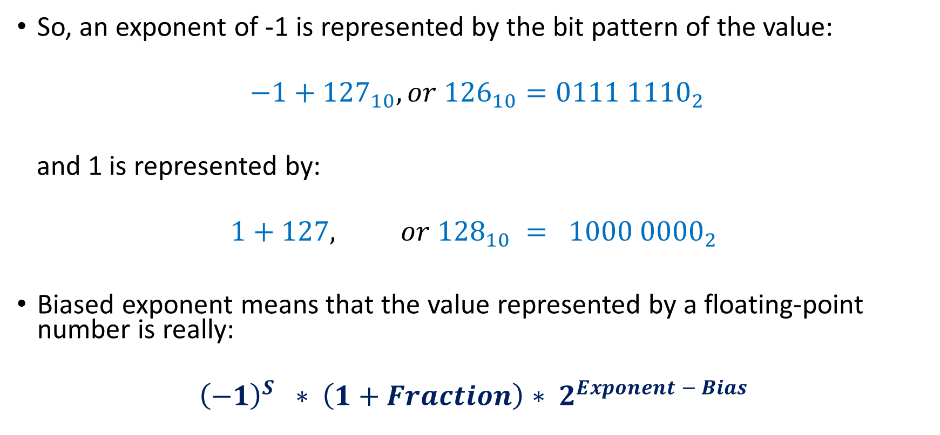
Floating Point Representation
So, an exponent of -1 is represented by the bit pattern of the value:
$$−1+{127}_{10}, or {126}_{10}=0111 {1110}_{2}$$
and 1 is represented by:
$$1+127, or {128}_{10} = 1000 {0000}_{2}$$
Biased exponent means that the value represented by a floating-point number is really:
$${\left(−1\right)}^{S} ∗ \left(1+Fraction\right)∗ 2^{Exponent − Bias}$$

Slide 17
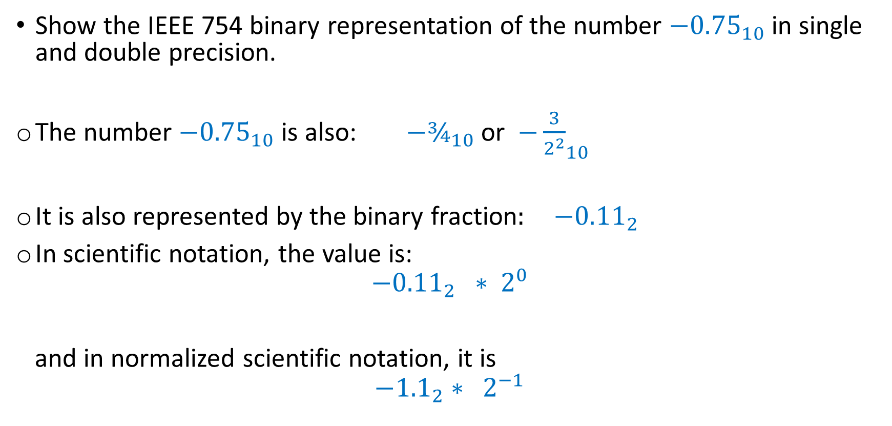
Floating Point Representation - Exercise
Show the IEEE 754 binary representation of the number ${−0.75}_{10}$ in single and double precision.
The number ${−0.75}_{10}$ is also: ${−¾}_{10}$or ${−\frac{3}{2^{2}}}_{10}$
It is also represented by the binary fraction: ${−0.11}_{2}$
In scientific notation, the value is:
$${−0.11}_{2} ∗ 2^{0}$$
and in normalized scientific notation, it is
$${−1.1}_{2}∗ 2^{−1}$$
Notes:
Weights: b0*2^2 + b1*2^1 + b2*2^0 + b3*2^-1 + b4*2^-2 …

Slide 18
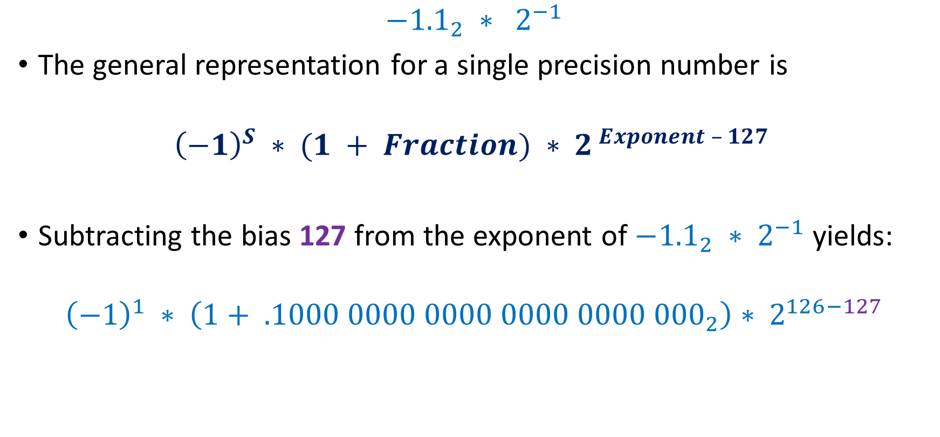
Floating Point Representation - Exercise
$${−1.1}_{2} ∗ 2^{−1}$$
The general representation for a single precision number is
$${\left(−1\right)}^{S} ∗ (1 + Fraction) ∗ 2^{ Exponent – 127 }$$
Subtracting the bias 127 from the exponent of ${−1.1}_{2} ∗ 2^{−1}$yields:
$${\left(−1\right)}^{1} ∗ \left(1+ .1000 0000 0000 0000 0000 {000}_{2}\right)∗ 2^{126−127}$$

Slide 19

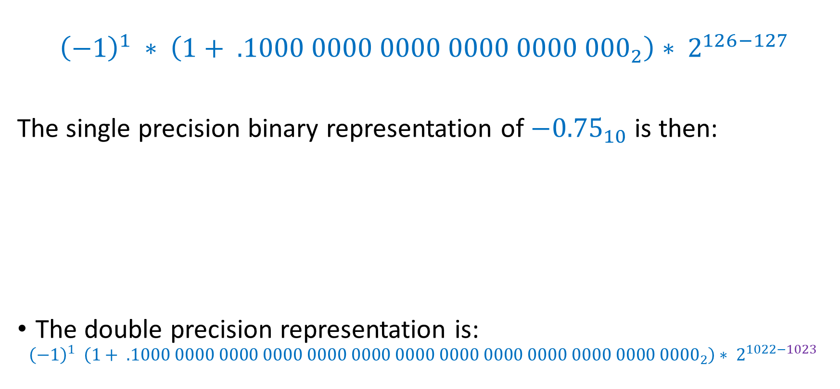
Floating Point Representation - Exercise
$${\left(−1\right)}^{1} ∗ \left(1+ .1000 0000 0000 0000 0000 {000}_{2}\right)∗ 2^{126−127}$$
The single precision binary representation of $−{0.75}_{10}$ is then:
The double precision representation is:
$${\left(−1\right)}^{1} \left(1+ .1000 0000 0000 0000 0000 0000 0000 0000 0000 0000 0000 0000 {0000}_{2}\right)∗ 2^{1022−1023}$$
Notes:
In the 8 bits field there is 126

Slide 20
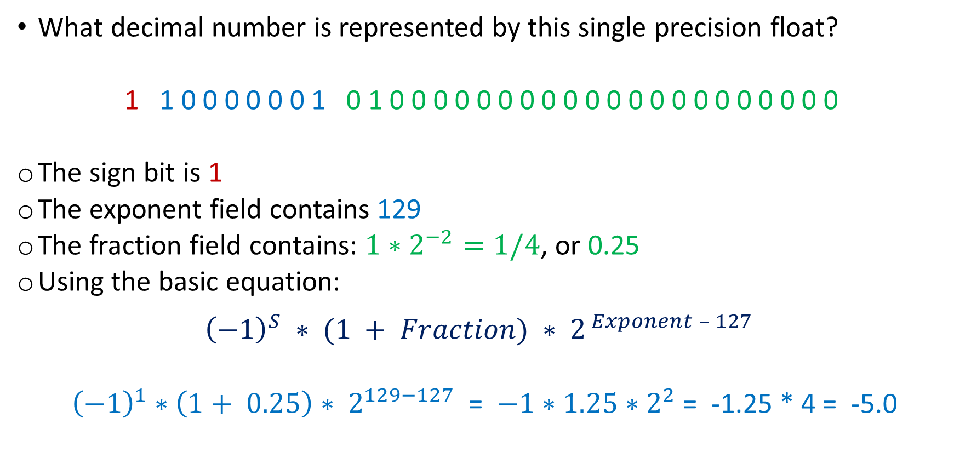
Floating Point Representation – Another exercise
What decimal number is represented by this single precision float?
1 1 0 0 0 0 0 0 1 0 1 0 0 0 0 0 0 0 0 0 0 0 0 0 0 0 0 0 0 0 0 0
The sign bit is 1
The exponent field contains 129
The fraction field contains: $1∗2^{−2}=1/4$, or 0.25
Using the basic equation:
$${\left(−1\right)}^{S} ∗ (1 + Fraction) ∗ 2^{ Exponent – 127 }$$
${\left(−1\right)}^{1}∗\left(1+ 0.25\right)∗ 2^{129−127}$ = $−1∗1.25∗2^{2}$ = -1.25 * 4 = -5.0

Slide 21
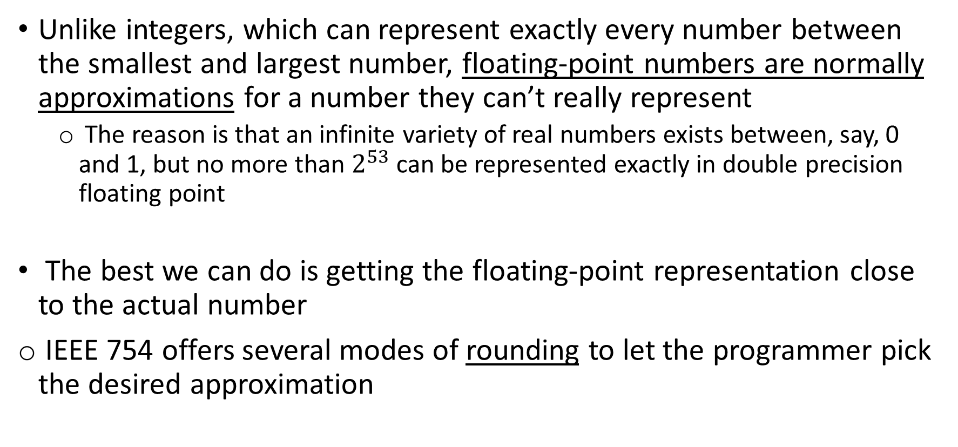
Accurate Arithmetic
Unlike integers, which can represent exactly every number between the smallest and largest number, floating-point numbers are normally approximations for a number they can’t really represent
The reason is that an infinite variety of real numbers exists between, say, 0 and 1, but no more than $2^{53}$ can be represented exactly in double precision floating point
The best we can do is getting the floating-point representation close to the actual number
IEEE 754 offers several modes of rounding to let the programmer pick the desired approximation

Slide 22
Accurate Arithmetic
Rounding sounds simple enough, but to round accurately requires the hardware to include extra bits in the calculation
If every intermediate result had to be truncated to the exact number of digits, there would be no opportunity to round
EEE 754, therefore, always keeps two extra bits on the right during intermediate additions, called guard and round, respectively
Let’s do a decimal example to illustrate their value…

Slide 23

Accurate Arithmetic - Exercise
Add $2.56∗{10}^{0}$to $2.34 ∗{10}^{2}$, assuming that we have 3 significant decimal digits.
Round to the nearest decimal number with three significant decimal digits, first with guard and round digits, and then without them.
Notes:
The values are decimal

Slide 24
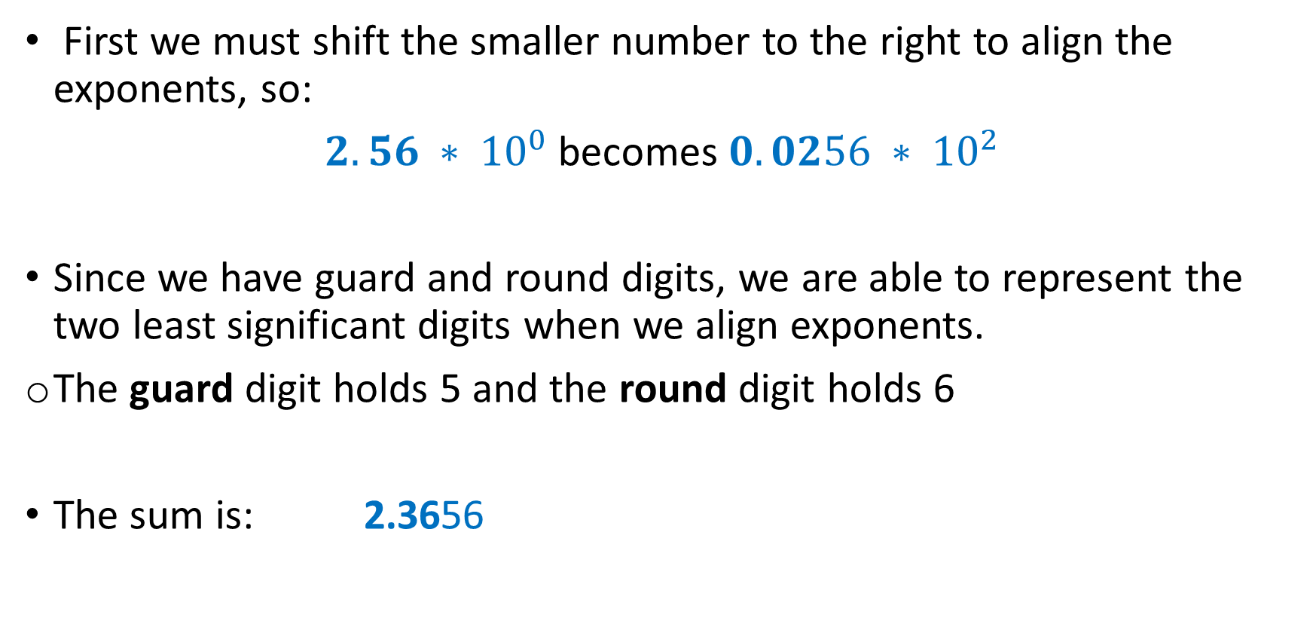
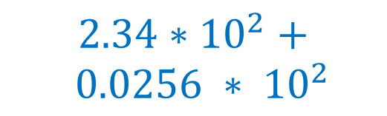
Accurate Arithmetic - Exercise
First we must shift the smaller number to the right to align the exponents, so:
$2.56 ∗ {10}^{0}$becomes $0.0256 ∗ {10}^{2}$
Since we have guard and round digits, we are able to represent the two least significant digits when we align exponents.
The guard digit holds 5 and the round digit holds 6
The sum is: 2.3656
Guard
$$2.34∗{10}^{2}+$$
$$0.0256 ∗ {10}^{2}$$
Round
Notes:
The values are decimal

Slide 25
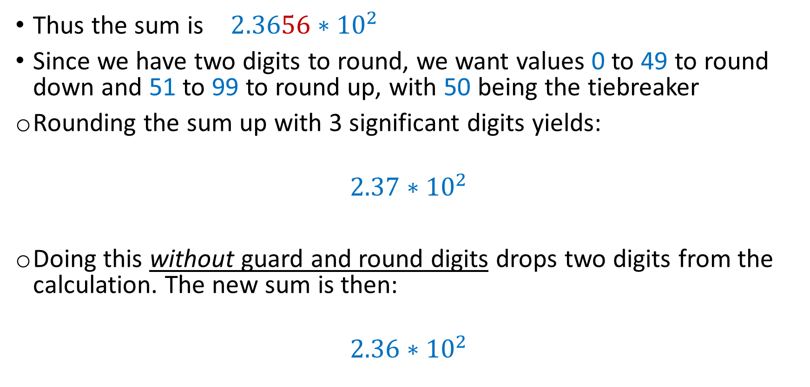
Accurate Arithmetic - Exercise
Thus the sum is $2.3656∗{10}^{2}$
Since we have two digits to round, we want values 0 to 49 to round down and 51 to 99 to round up, with 50 being the tiebreaker
Rounding the sum up with 3 significant digits yields:
$$2.37∗{10}^{2}$$
Doing this without guard and round digits drops two digits from the calculation. The new sum is then:
$$2.36∗{10}^{2}$$
Notes:
The values are decimal

Slide 26
Accurate Arithmetic
Accuracy in floating point is normally measured in terms of the number of bits in error in the least significant bits of the significand
The measure is called the number of units in the last place, or ulp
If a number were off by 2 in the least significant bits, it would be called off by 2 ulps
Provided there is no overflow, underflow, or invalid operation exceptions, IEEE 754 guarantees that the computer uses the number that is within one-half ulp
Notes:
Since the worst case for rounding would be when the actual number is halfway between two floating-point representations

Slide 27
Accurate Arithmetic
IEEE 754 has four rounding modes:
Always round up (toward +∞)
Always round down (toward -∞)
Truncate
Round to nearest even
The final mode determines what to do if the number is exactly halfway in between. IEEE 754 says that if the least significant bit retained in a halfway case is:
odd, add one
even, truncate
Notes:
This method always creates a 0 in the least significant bit in the tie-breaking case, giving the rounding mode its name.
This mode is the most commonly used, and the only one that Java supports.

Slide 28
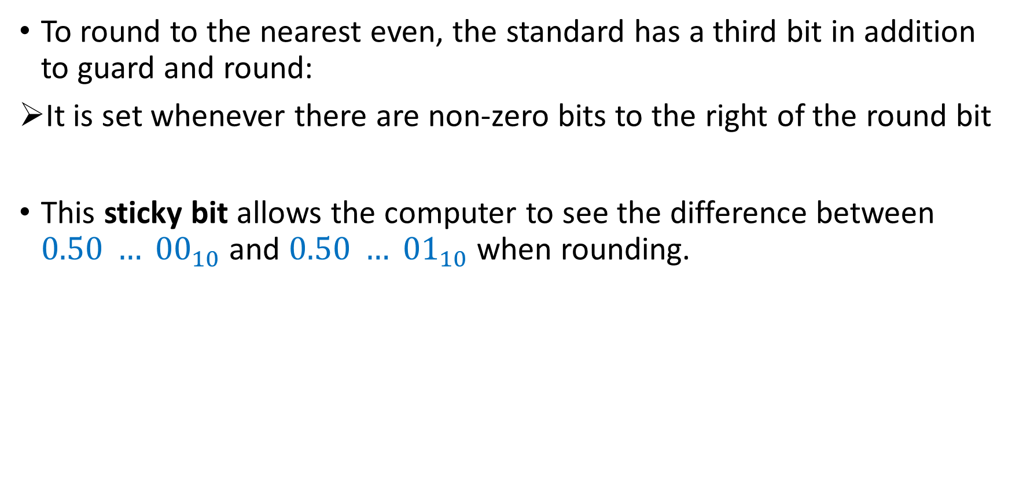
Accurate Arithmetic
To round to the nearest even, the standard has a third bit in addition to guard and round:
It is set whenever there are non-zero bits to the right of the round bit
This sticky bit allows the computer to see the difference between $0.50 … {00}_{10}$and $0.50 … {01}_{10}$when rounding.

Slide 29
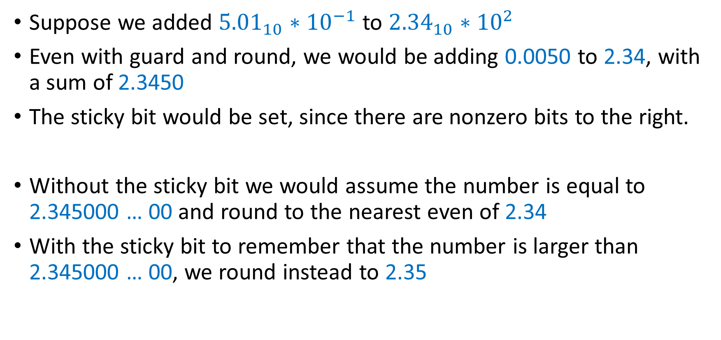
Accurate Arithmetic – Example
The 1 is gone!
Suppose we added ${5.01}_{10}∗{10}^{−1}$ to ${2.34}_{10}∗{10}^{2}$
Even with guard and round, we would be adding 0.0050 to 2.34, with a sum of 2.3450
The sticky bit would be set, since there are nonzero bits to the right.
Without the sticky bit we would assume the number is equal to 2.345000 … 00 and round to the nearest even of 2.34
With the sticky bit to remember that the number is larger than 2.345000 … 00, we round instead to 2.35
Notes:
We lost something…
0.00501 <- this 1

